Slide 1
Judith Sargent Murray
A Will of My Own
1751-1820
“Yes, I confess it -- I do sigh for fame…”

Slide 2
John Singleton Copley Portrait
Today housed in the Art Institute of Chicago.
"Let ... female curiosity cease to be considered a term of reproach." 1794

Slide 3
First Letter to Rev. Murray
, "I am not much accustomed to writing letters, especially to your sex, but if there be neither male nor female in the Emmanuel you promulgate, we may surely, and with the strictest propriety, mingle souls upon paper."

Slide 4
Universalist Catechism, 1782
Title: Some Deductions from the System Promulgated in the Page of Divine Revelation: Ranged in the Order and Form of a Catechism Intended as an Assistant to the Christian Parent or Teacher.
Privately published in Portsmouth, New Hampshire, and Norwich, Connecticut.
Considered the earliest writing by an American Universalist woman. Written for children, the question-and-answer format neatly explains the Universalist theology.

Slide 5
“Desultory Thoughts upon the Utility of Encouraging a Degree of Self-Complacency in Female Bosoms”
On marriage:
Certainly love, friendship and esteem, ought to take place of marriage, but, the woman thus circumstanced, will seldom regard these previous requisites to felicity, if she can but insure the honors, which she, in idea, associates with a matrimonial connection—to prevent which great evil, I would early impress under proper regulations, a reverence of self.
Gentleman and Lady’s Town and Country Magazine in 1784

Slide 6
John Murray Proposes
John Murray "acknowledged he had long loved me, even from the commencement of our acquaintance, with ardour loved me, but that he would have sacrificed his life, rather than have admitted a thought in this regard to me, which my own guardian angel would blush to own, but that, as I had now for many months been released from my early vows, he presumed to calculate upon a favourable hearing."

Slide 7
My reply
---I shall be---in short I shall be very happy—a thousand times a day, do I whisper the tidings to my soul, My heart, my fond heart, throbs with esteem, and gratitude, hourly augmenting, and the pleasing perturbations of the little flutterer seems to render it too big for its enclosure…..---I cannot write a kind of pleasing tumult takes possession of my soul…Welcome then, my dearest friend---Thou art right welcome to the soul of thy Constantia.”

Slide 8
Publishes “On the Equality of the Sexes”
“Will it be said that the judgment of a male of two years old, is more sage than that of a female's of the same age? I believe the reverse is generally observed to be true. But from that period what partiality! how is the one exalted, and the other depressed, by the contrary modes of education which are adopted! the one is taught to aspire, and the other is early confined and limited. As their years increase, the sister must be wholly domesticated, while the brother is led by the hand through all the flowery paths of science. Grant that their minds are by nature equal, yet who shall wonder at the apparent superiority, if indeed custom becomes second nature.”
"On the Equality of the Sexes," in 1790, in the Massachusetts Magazine.
"I would calmly ask, is it reasonable, that a candidate for immortality, for the joys of heaven, an intelligent being, who is to spend an eternity in contemplating the works of Deity, should at present be so degraded, as to be allowed no other ideas, than those suggested by the mechanism of a pudding, or the sewing [of] the seams of a garment? “

Slide 9
1791 Julia Maria Murray
"Was I the father of a family...I would give my daughters every accomplishment which I thought proper ... they should be enabled to procure for themselves the necessaries of life, independence should be placed within their grasp, and I would teach them to reverence themselves.”
“…you must learn to reverence yourself, that is, your intellectual existence; you must endeavor to adorn your mind, for, it is from the proper furnishing of that you will become indeed a valuable person…”
“I would from the early dawn of reason, address her as a rational being; hence, I apprehend, the most valuable consequences would result” (Desultory Thoughts)

Slide 10
Public Speech
“Education is better than gold, for misfortune may strip the affluent of their possessions, but, while reason is continued, the abundant, and precious utility of instruction, will remain; and a well-informed individual , although reduced, by multiplied pecuniary losses, may be again enriched by a thousand different modes-----Education is an enduring resource in the day of calamity, …

Slide 11
Of the student:
"Education liberal and refined
Softens the rude and tames the savage mind."
Of the teachers: “…preceptors should be informed, experienced, interested, liberal, candid, indulgent, unyielding, long suffering, and judicious….” (Repository)

Slide 12
“I think to teach young minds to aspire, ought to be the groundwork of education;…. Ambition is a noble principle… I would have my pupils believe, that everything in the compass of morality, was placed within their grasp, and that, the avidity of application, the intenseness of study, were only requisite to endow them with every external grace and mental accomplishment.” (Desultory Thoughts)

Slide 13
“On the Equality of the Sexes”
“After an education which limits and confines, and employments and recreations which naturally tend to enervate the body and debilitate the mind; after we have from early youth been adorned with ribbons…, dressed out like the ancient victims previous to a sacrifice, being taught by the care of our parents in collecting the most showy material that the ornamenting our exterior ought to be the principal object of our attention; after fifteen years thus spent, we are introduced into the world,…. It is expected that with the other sex we should commence immediate war, and that we should triumph over the machinations of the most artful. We must be constantly upon our guard; prudence and discretion must be our characteristics; and we must rise superior to, and obtain a complete victory over [the other sex] who have been long adding to their native strength by an unremitted study of men and books.”

Slide 14
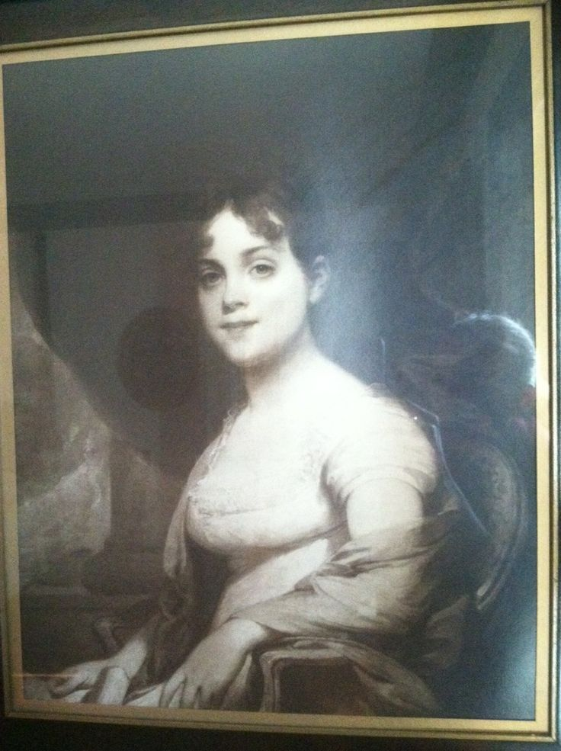
Adam Lewis Bingaman
Julia Maria Murray Bingaman

Slide 15
Judith Sargent Murray's letter books, discovered in 1984 in Natchez, Mississippi, by Unitarian Universalist minister Gordon Gibson, are at the Mississippi Department of Archives and History in Jackson, Mississippi. They have been published on microfilm.

Slide 16
Tombstone Inscription
"Dear spirit, the monumental stone can never speak thy worth."

