Slide 1
Professional Development Opportunities for Teachers
NHD in Mississippi Workshop
Lynne O’Hara, NHD Director of Programs

Slide 2
What are you seeking in professional development opportunities?

Slide 3
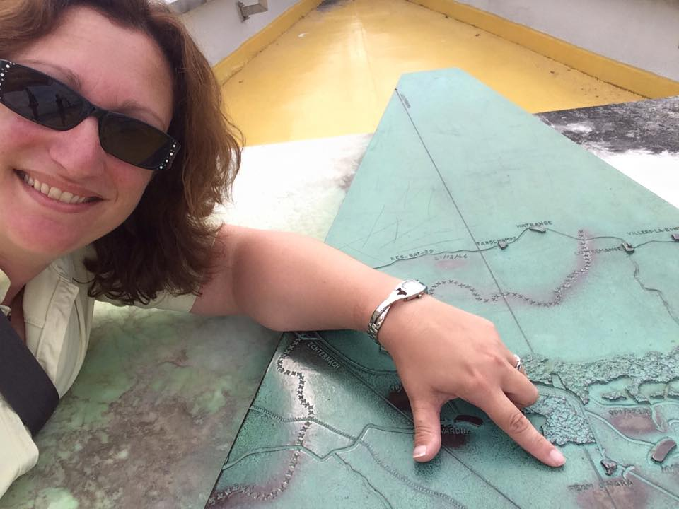
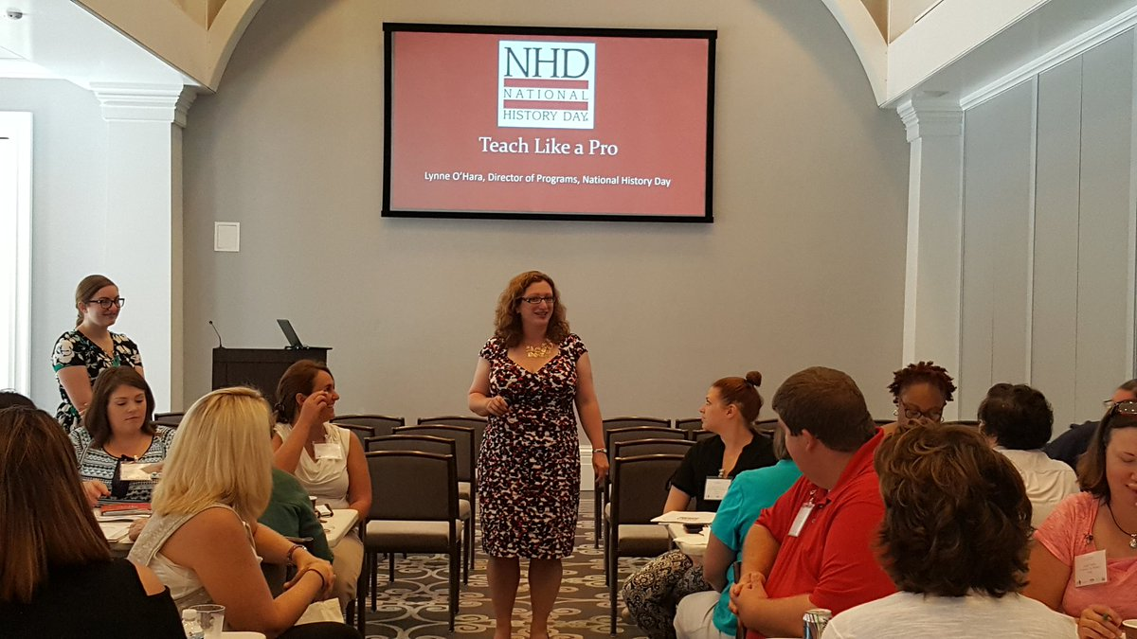
Introduction

Slide 4

What is NHD?

Slide 5
Goals of NHD
NHD
critical thinking
citizenship
argumentation
historical thinking

Slide 6
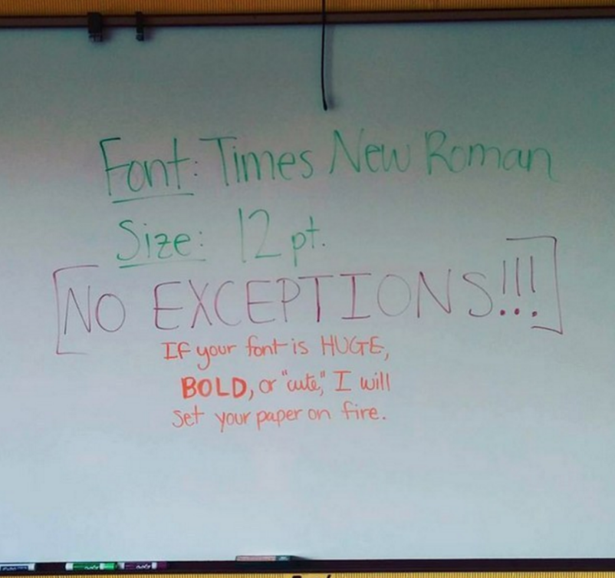

Slide 7

Secret of NHD

Slide 8

NHD Theme Book
www.nhd.org/themebook www.nhd.org/partner-resources

Slide 9
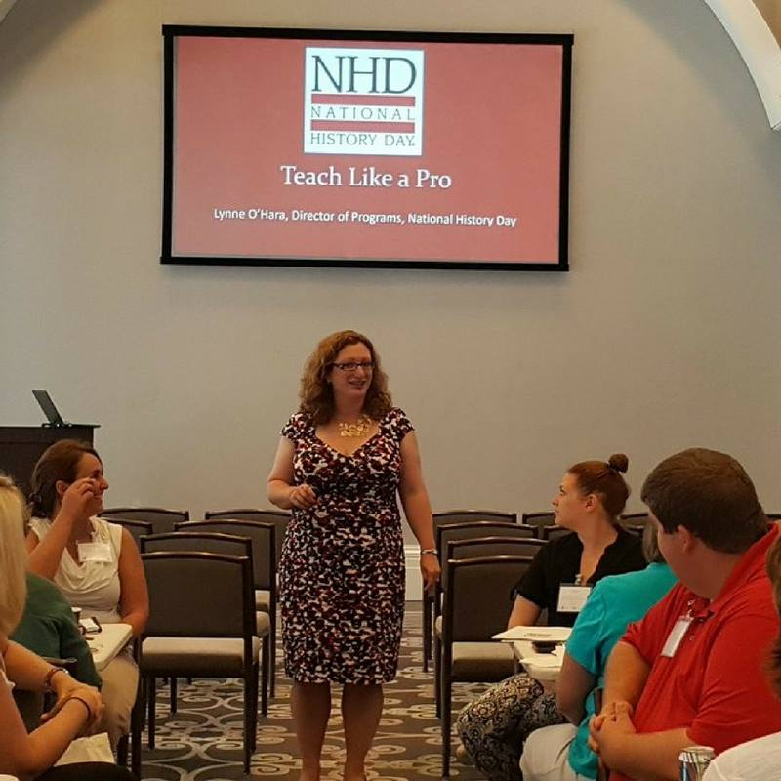
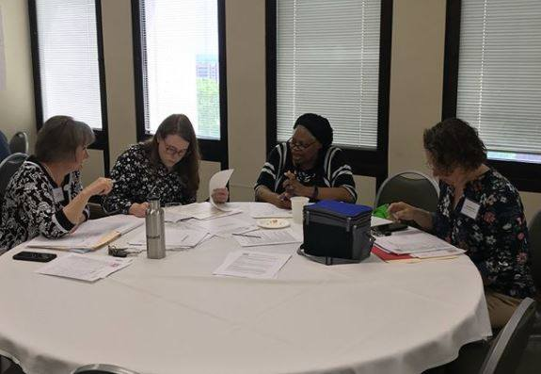
Local Teacher Workshops
https://www.usm.edu/history/national-history-day-mississippi

Slide 10
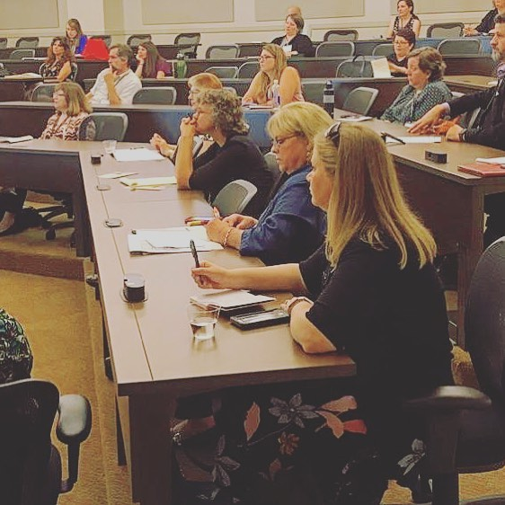
Contest Teacher Workshops

Slide 11
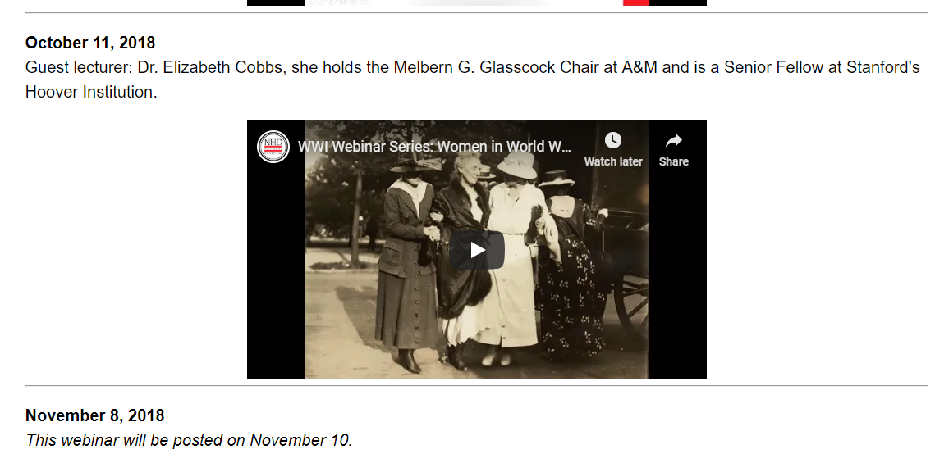
Content Webinars Posted
https://www.nhd.org/legacies-world-war-i

Slide 12
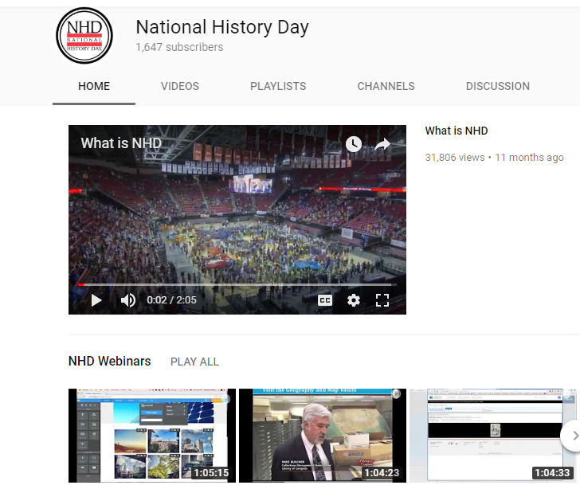

Webinars & YouTube Live programs
https://www.youtube.com/nationalhistory

Slide 13

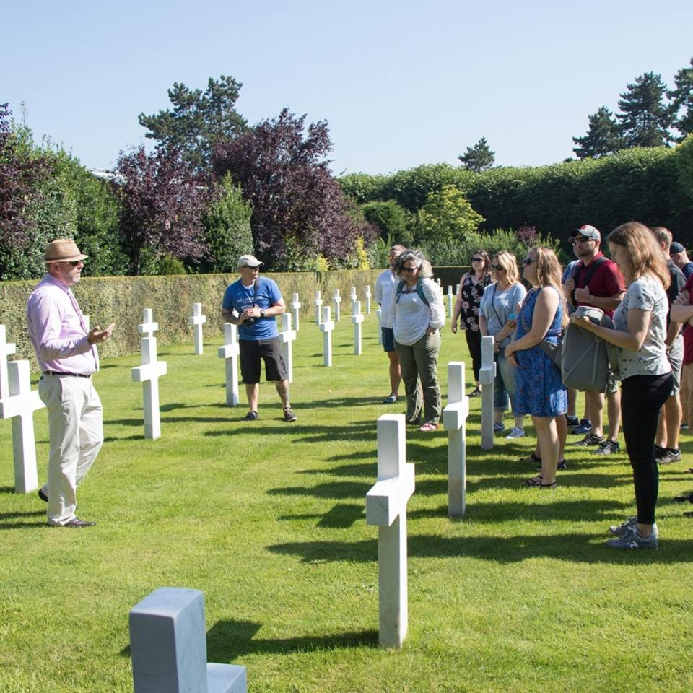
Summer Teacher Institutes

Slide 14

Online Graduate Courses
https://www.nhd.org//onlineeducation

Slide 15

www.nhd.org/who-they-were
Classroom Toolkit – Who They Were

Slide 16
Section Two:
Six Keys to
Embedding NHD in your Classroom

Slide 17

1. Create the Calendar
School Calendar
NHD Calendar - regional, affiliate, National Contest

Slide 18
1. Create the Calendar
Skills
Topics
Research
Creation
Contest

Slide 19
2. Pace Your Year
Skills
Topics
Research
Creation
Contest
ONGOING
October
October to Thanksgiving
Thanksgiving - January
February - June

Slide 20
2. Pace Your Year
REVISION
Skills
Topics
Research
Creation
Contest
ONGOING
late September
mid-September to Thanksgiving
Thanksgiving - January
February - June

Slide 21
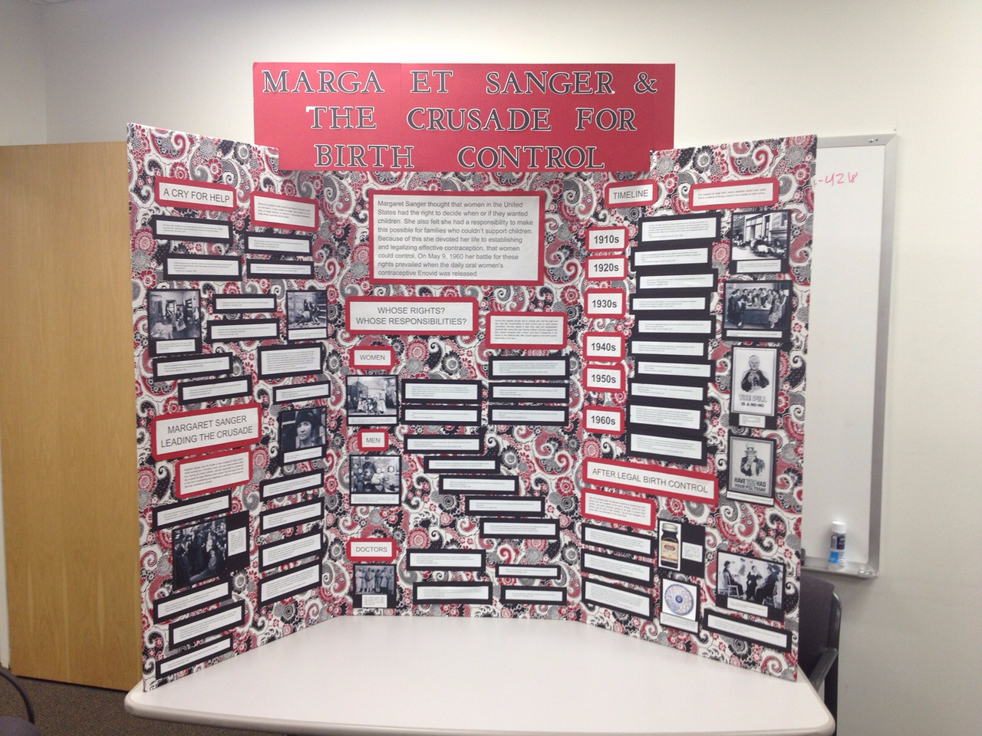

Slide 22
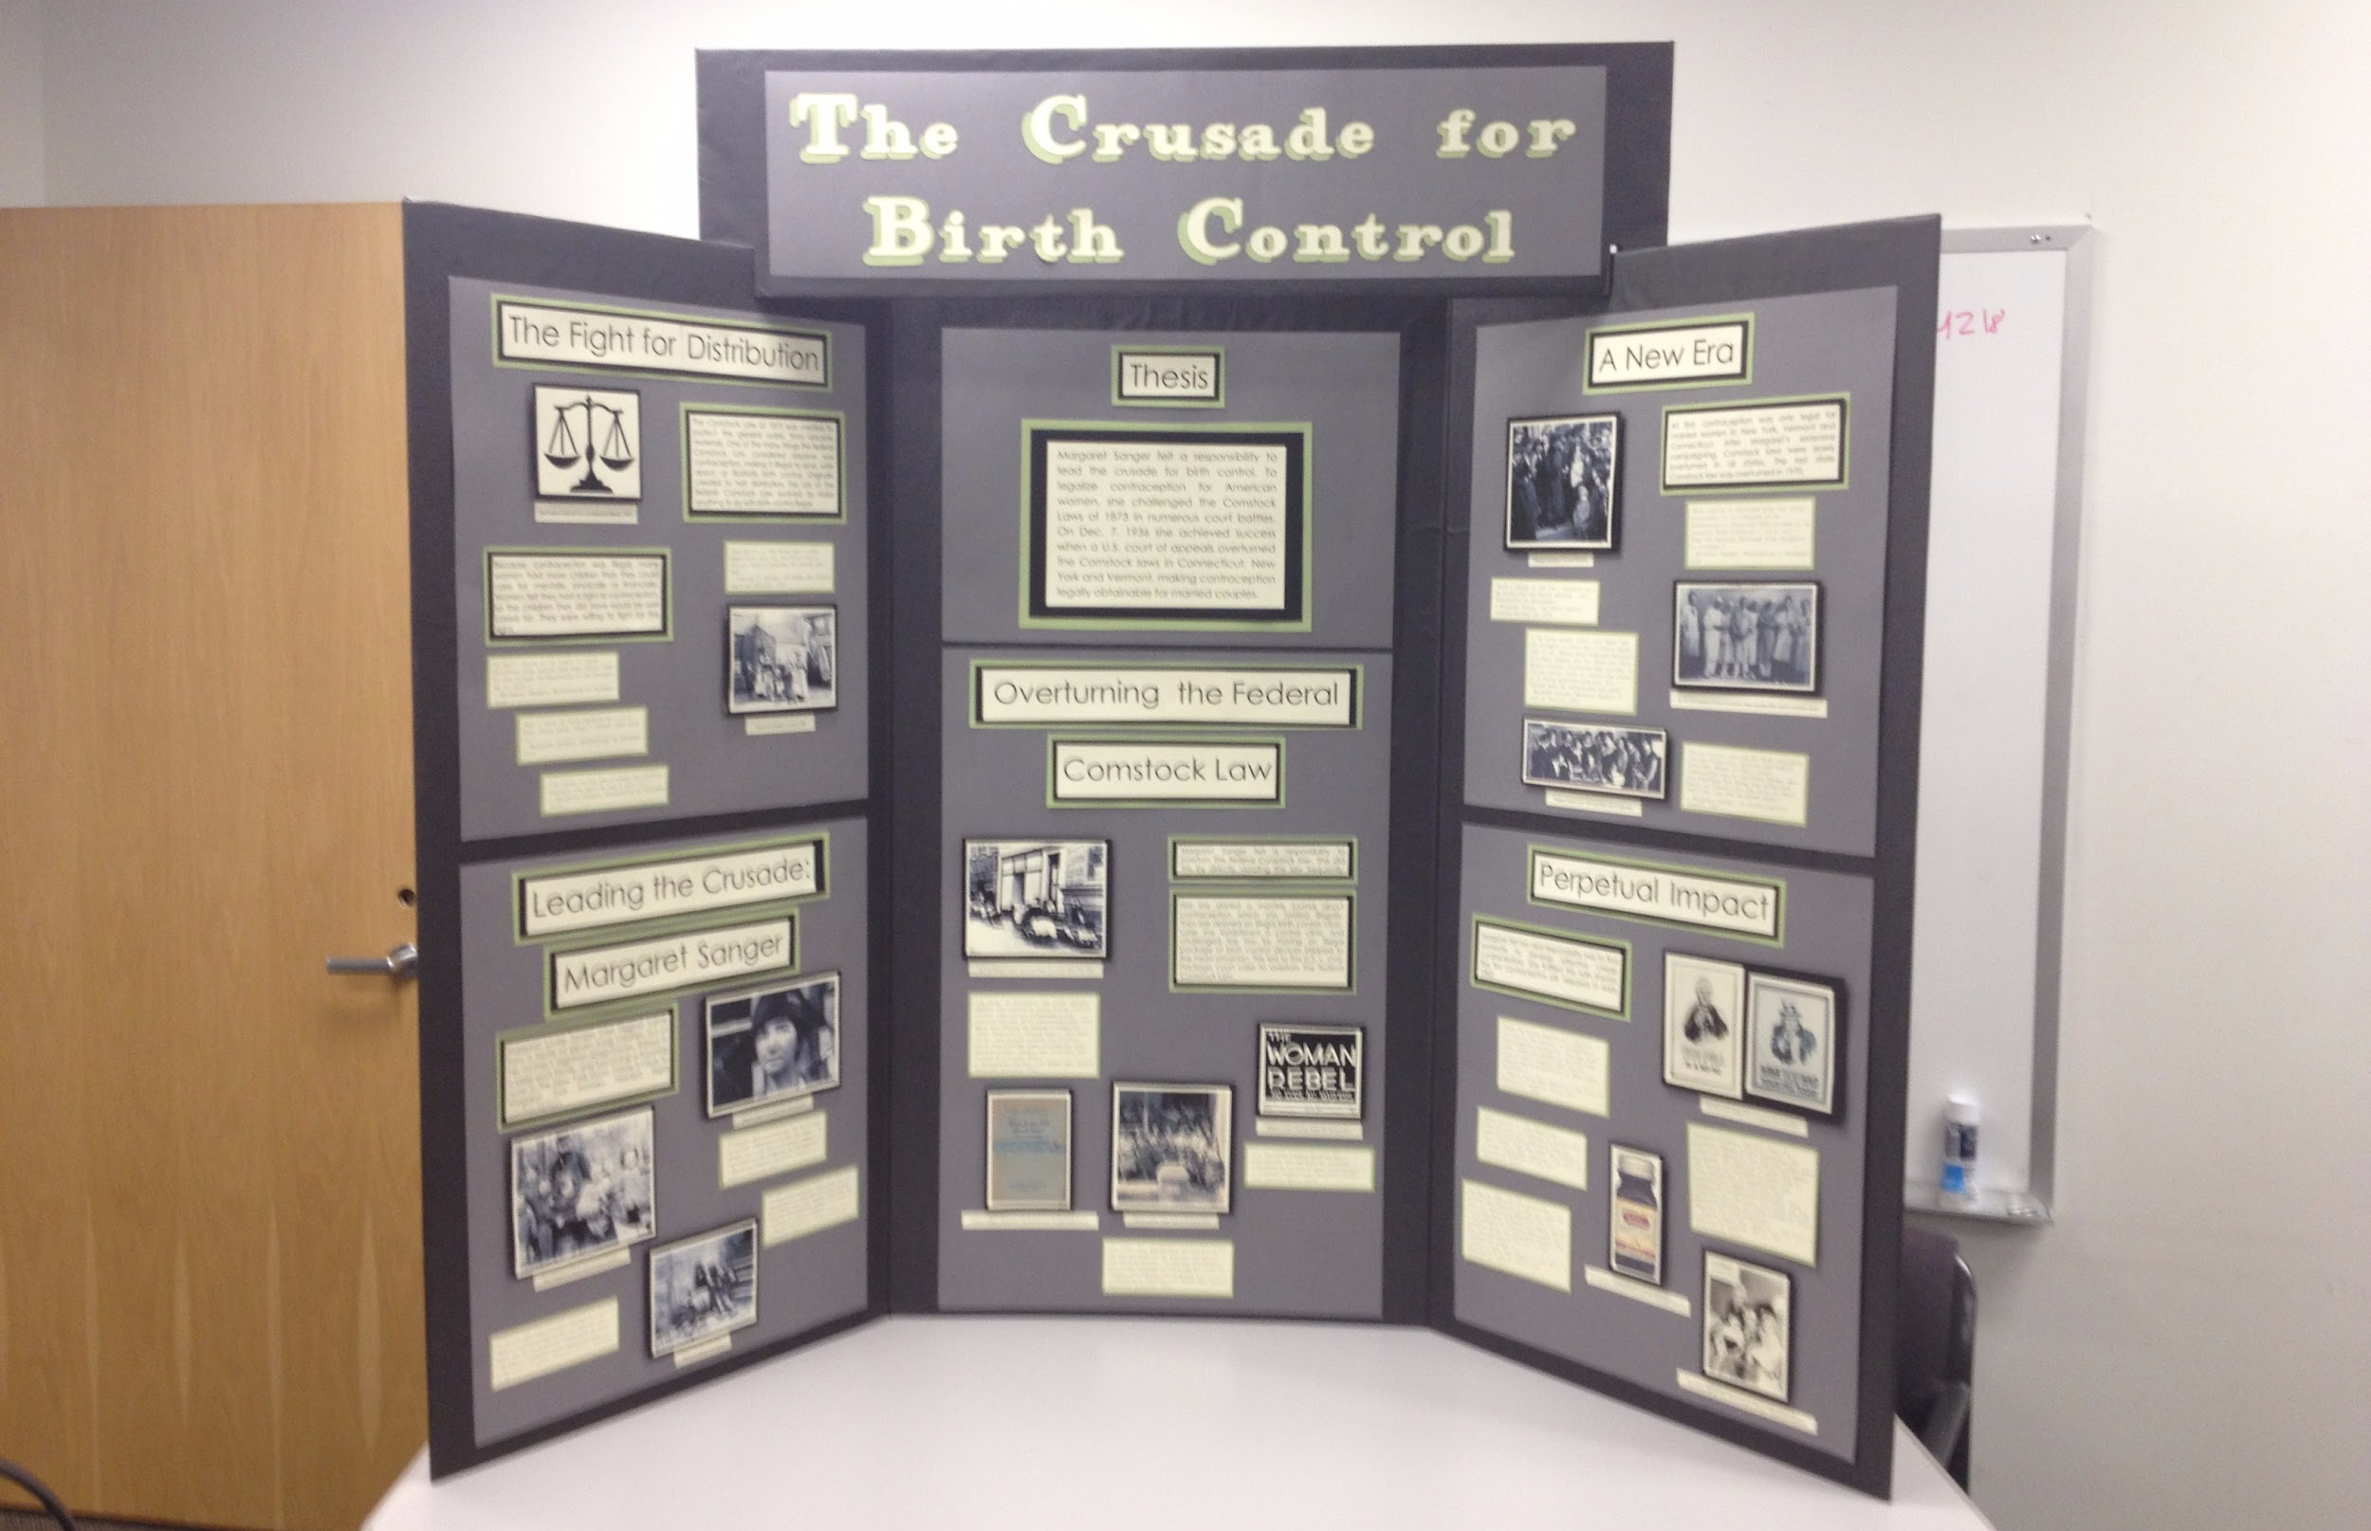

Slide 23
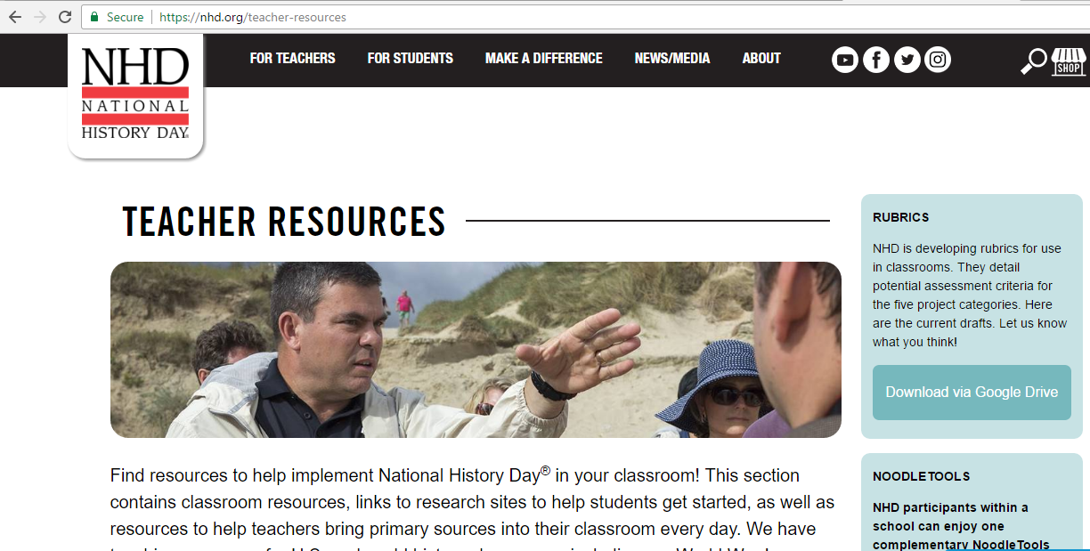
3. Beg, Borrow, Steal
www.nhd.org/teacher-resources

Slide 24

4. Find a Mentor

Slide 25
5. Plan your Assessment
www.nhd.org/teacher-resources

Slide 26

6. Create a Culture of Recognition

Slide 27

Questions?

Slide 28
Feedback Survey: https://tinyurl.com/NHDinMS
Ask Lynne anything
(that won’t get me fired)

