Slide 1
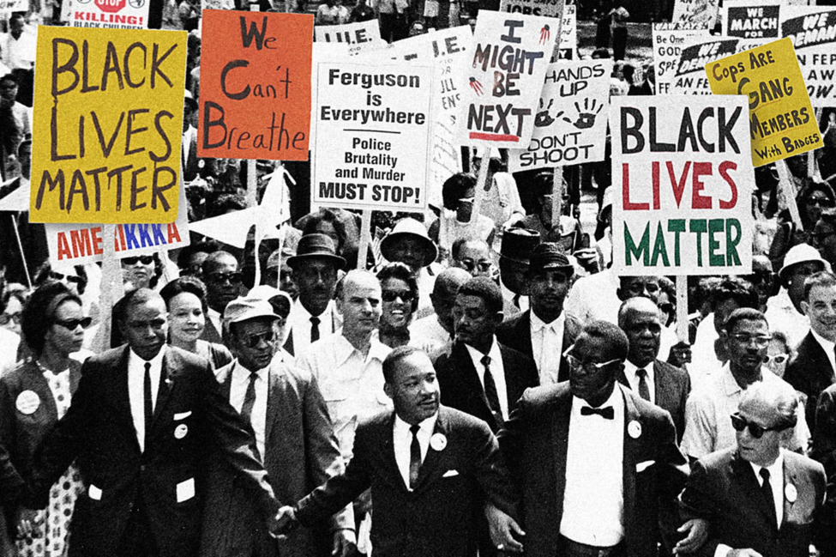

“Not Even Past”
Exploring the Useable Past in the Classroom
Shennette Garrett-Scott
University of Mississippi
EbonRebel

Slide 2
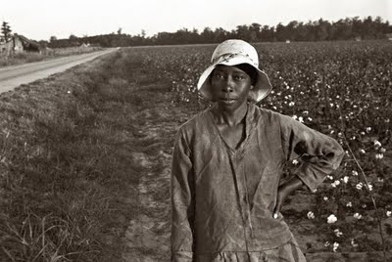
Introduction
“I am yet waitin’”
Black Women and the Freedman’s Bank

Slide 3
The past is never dead.
It’s not even past.
William Faulkner

Slide 4

Objectives
African American history not a parallel history.
Students should grapple with the complexities
of the past.
History matters when students make connections to issues important to them now.

Slide 5

bit.ly/UseablePast
Online link to lessons and resources

Slide 6
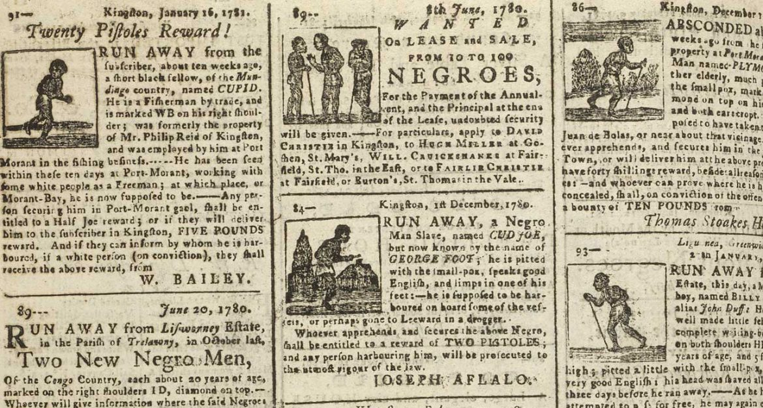
Mississippi Runaway Ads

Slide 7
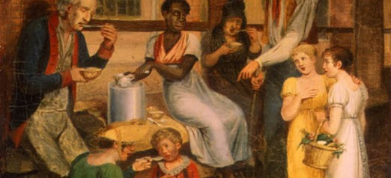
Market Women

Slide 8
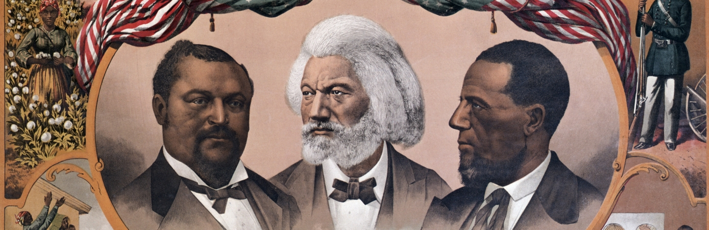
Black Reconstruction

Slide 9
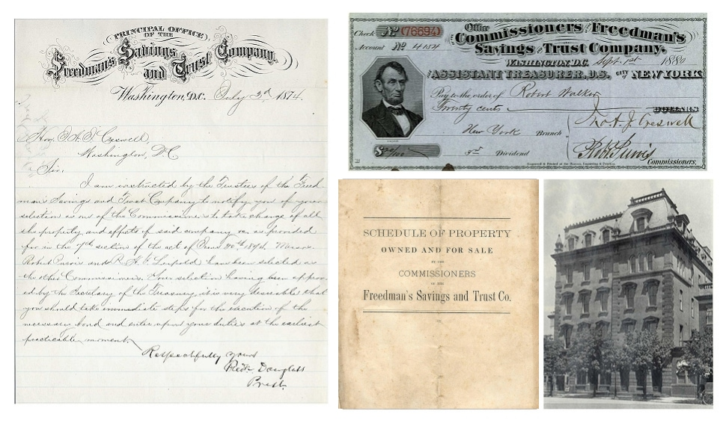
Freedman’s Bank

Slide 10
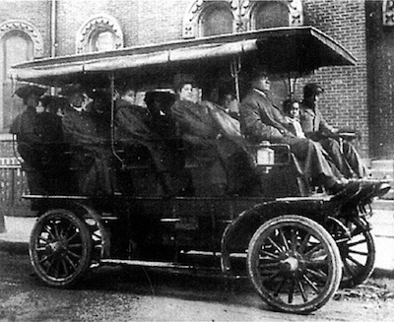
Boycott!

Slide 11
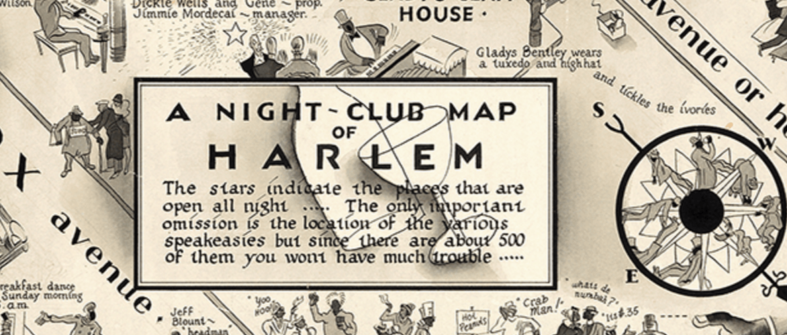
Numbers in Harlem

Slide 12
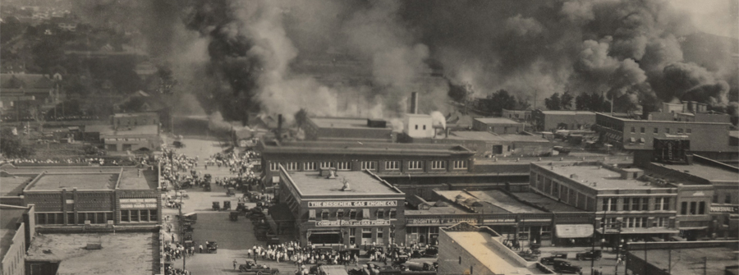
Riot

Slide 13
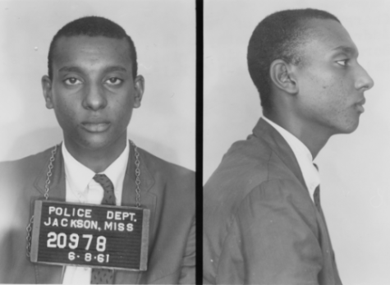
Spies in Mississippi

Slide 14

#BankBlack

Slide 15
bit.ly/UseablePast
Online link to lessons and resources

