Slide 1
“…So They See Themselves in the History We Are Teaching...”:
Youth Activism, Then & Now
DAPHNE R. CHAMBERLAIN, PH.D.
TOUGALOO COLLEGE

Slide 2
FREEDOM

Slide 3
freedom n. 1. The condition of being free. 2.a. Political independence. b. Possession of civil rights. 3. Ease of movement. 4. Frankness or boldness.
5. Unrestricted use or access.

Slide 4
Engaging students in a critical and meaningful dialogue…
What did FREEDOM mean to youths in the age of Jim Crow?
What prompted their activism during the civil rights era?
How does an examination of youth activism enhance narratives of struggle and resistance?
How does youth activism of the 1960s inform our understanding of contemporary social movements?

Slide 5
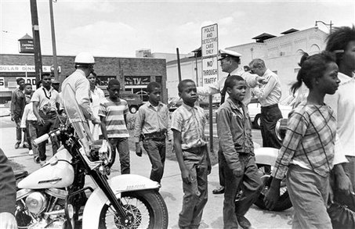

Slide 6
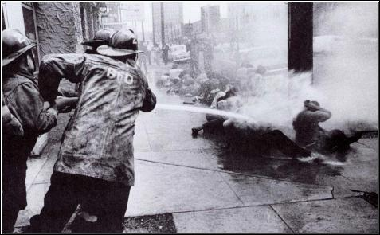

Slide 7
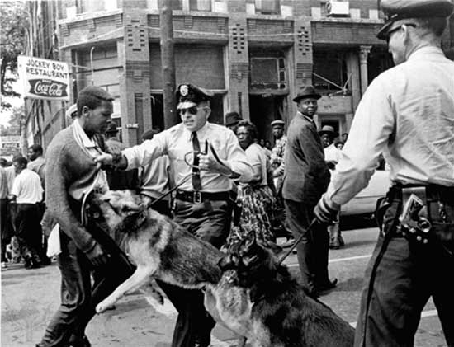

Slide 8
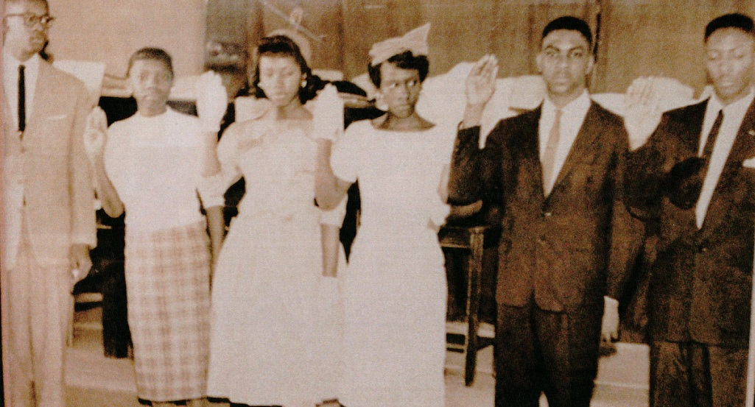
Photo courtesy of Rev. Dr. Amos C. Brown, Sr.

Slide 9
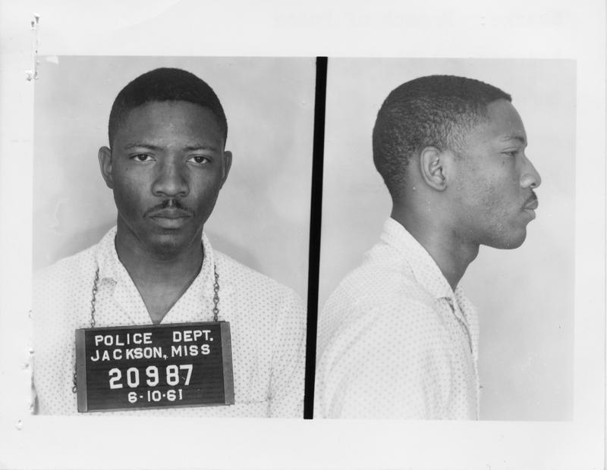
Mississippi State Sovereignty Commission, “Mississippi State Sovereignty Commission Photograph,” June 10, 1961, SCR ID# 2-55-4-50-1-1-1ph, Mississippi Department of Archives & History.

Slide 10
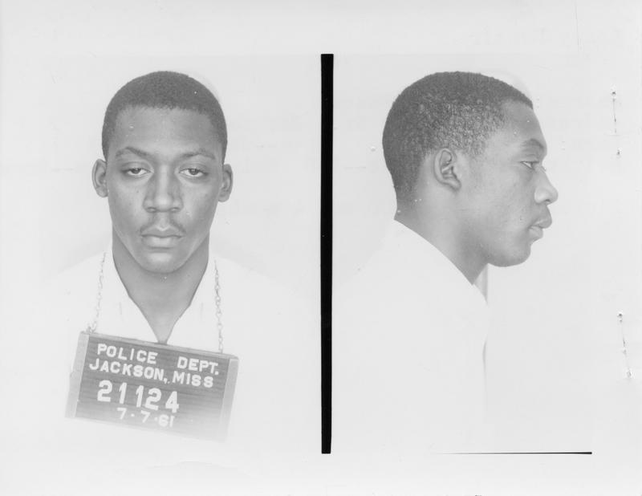
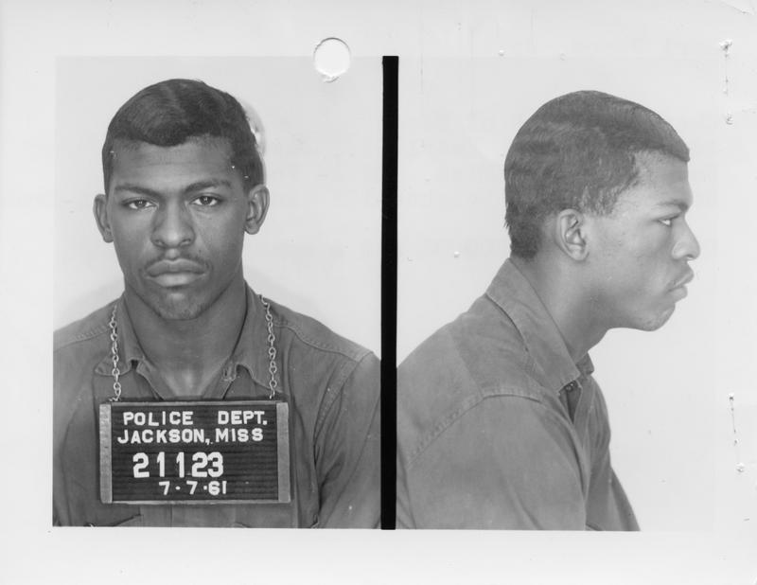
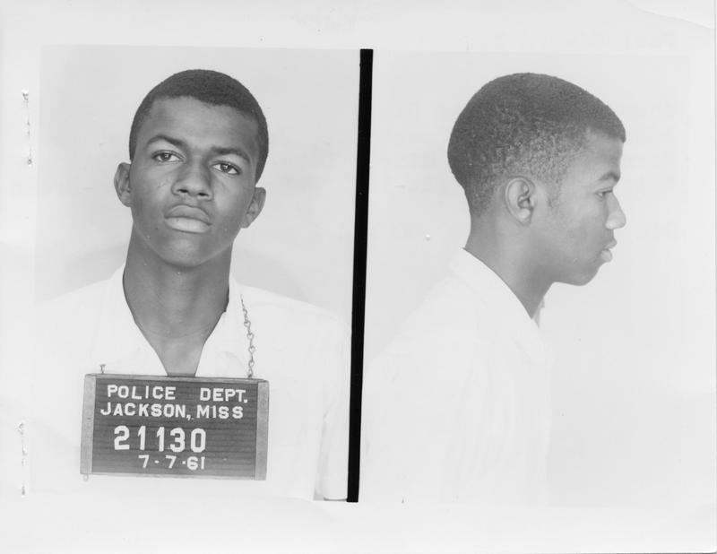
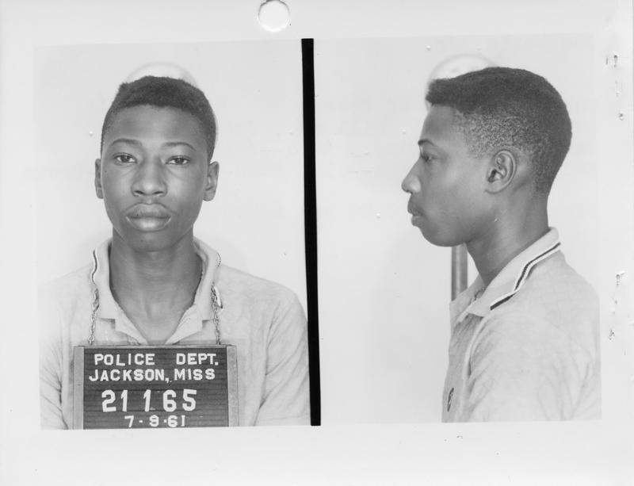
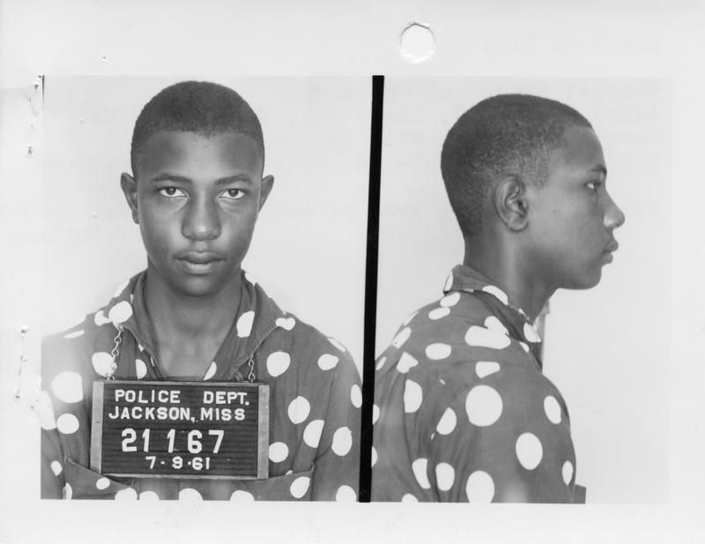
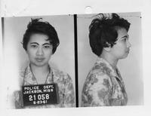
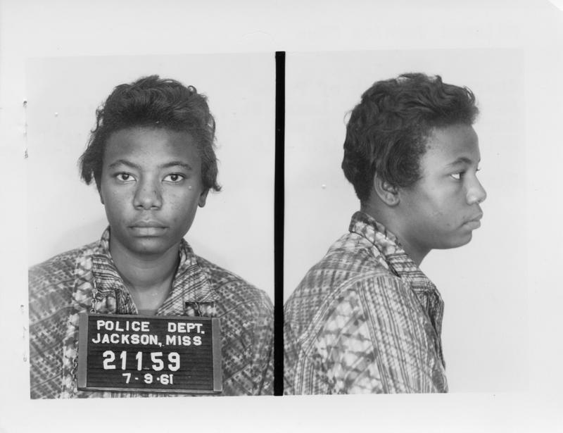
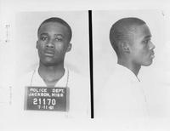
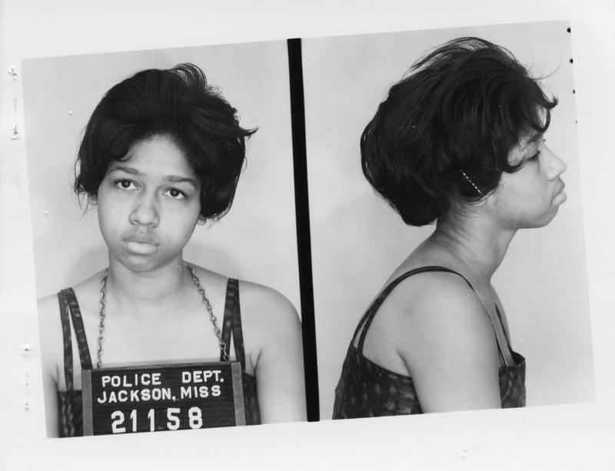
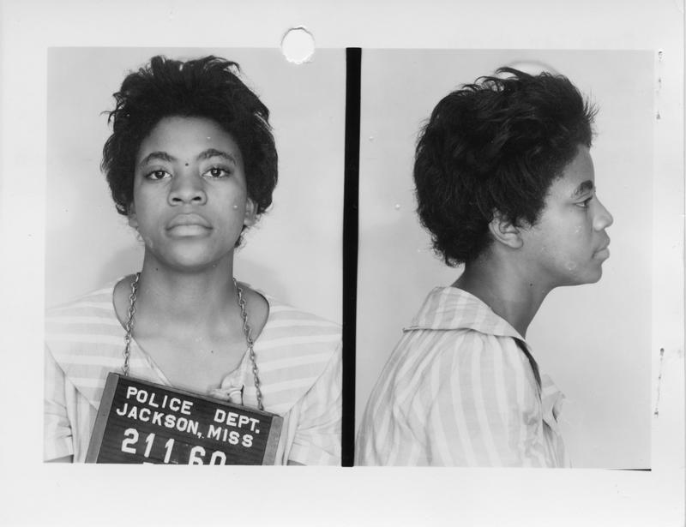
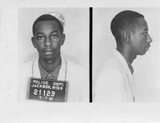
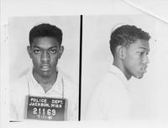
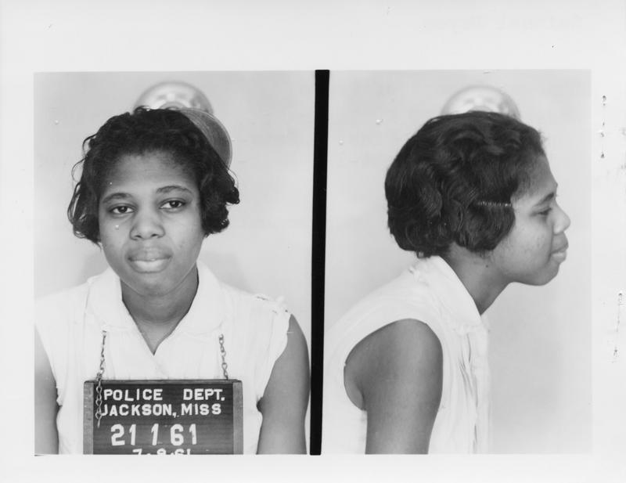
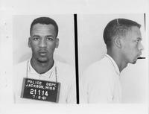

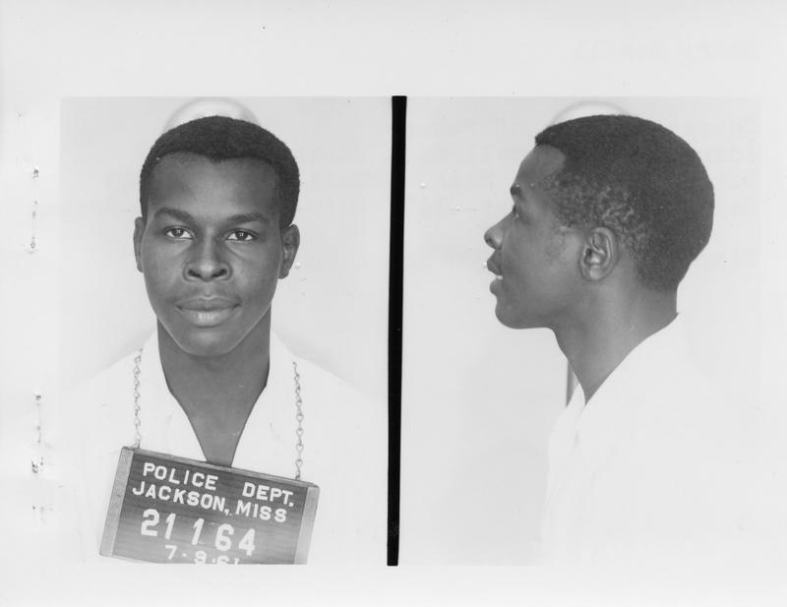
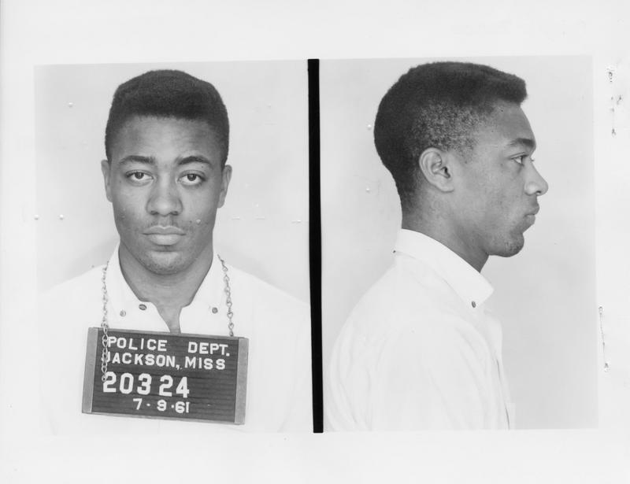
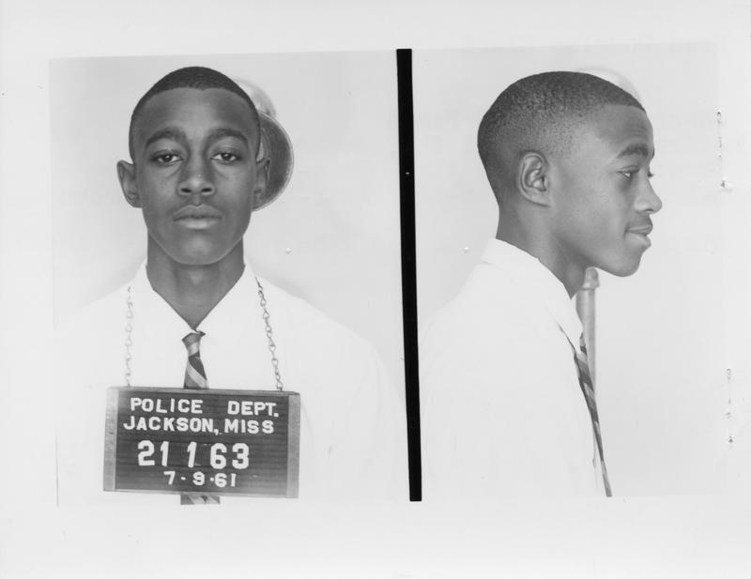
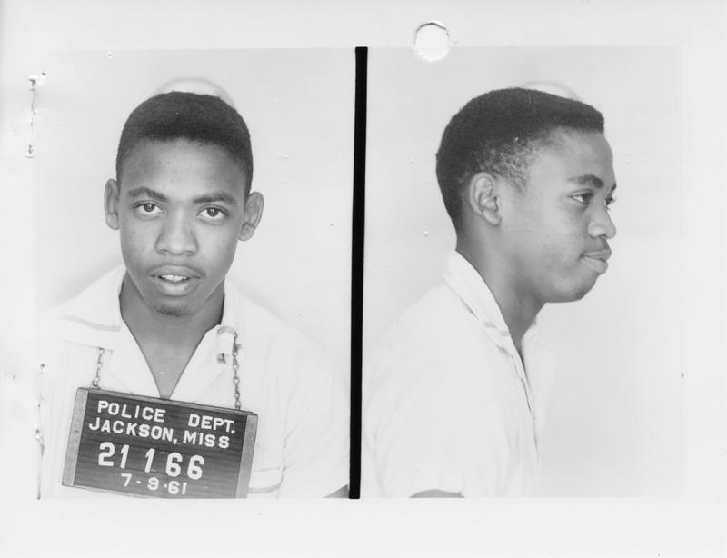
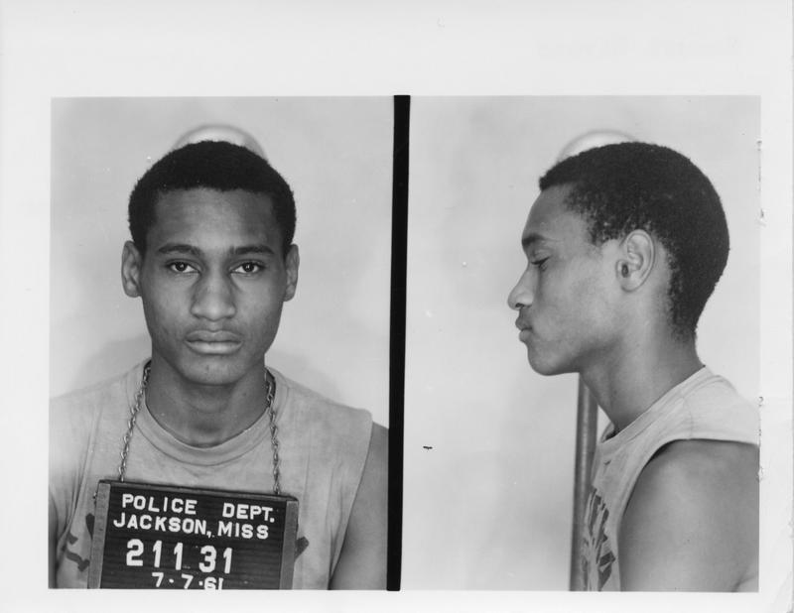

Slide 11
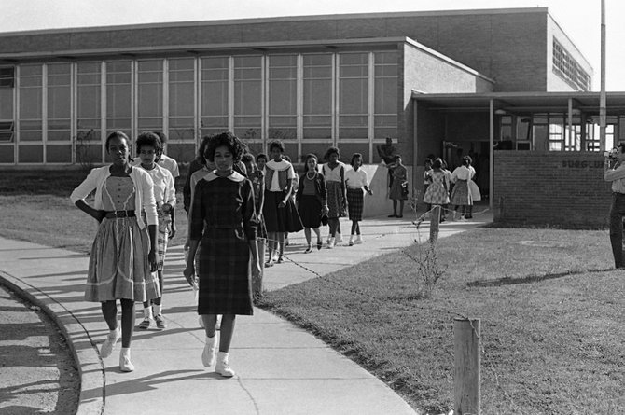
Burglund High School Walkout, 1961

Slide 12
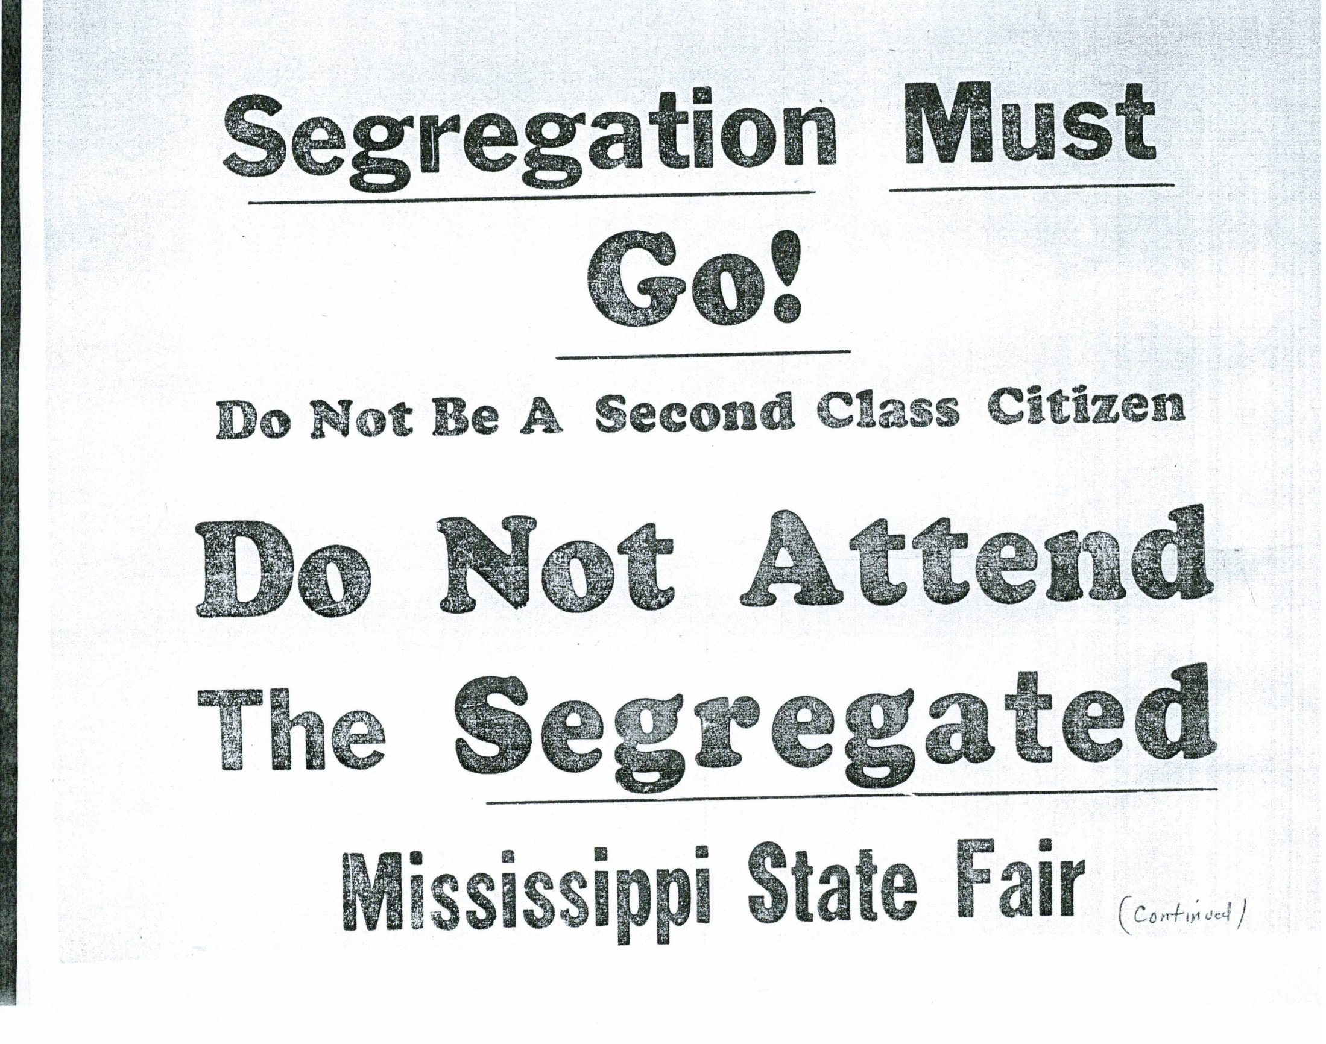

Slide 13
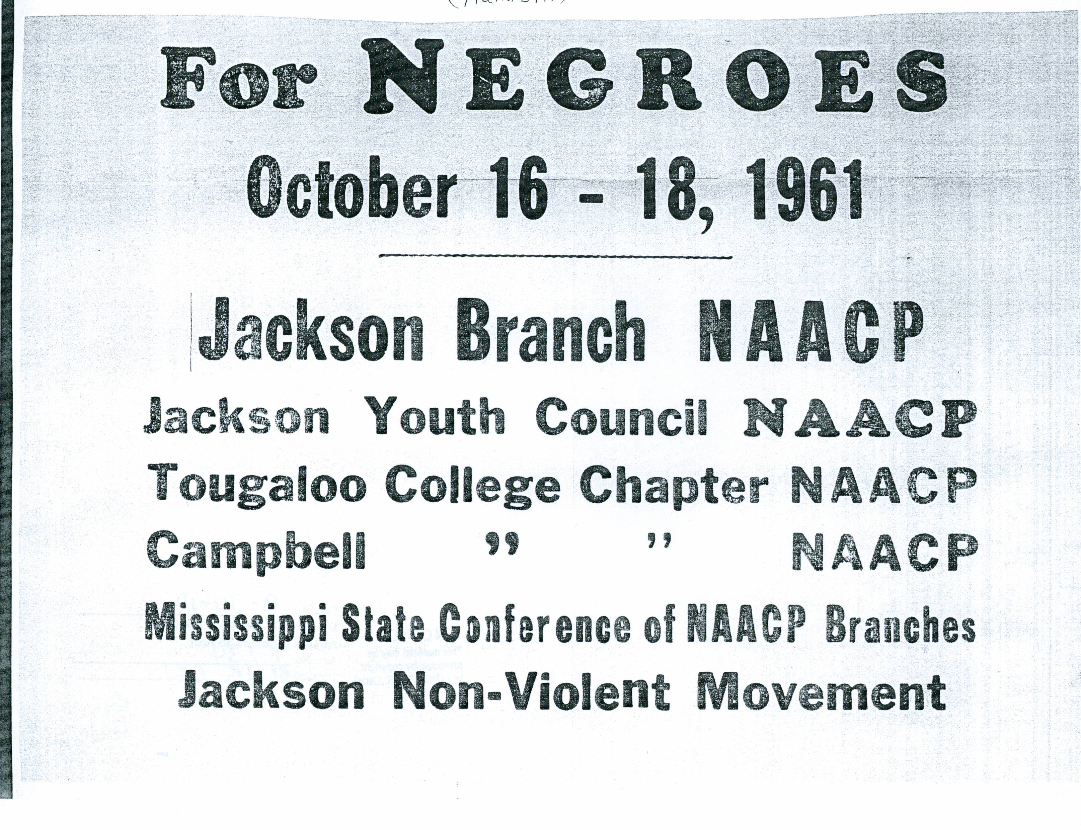

Slide 14
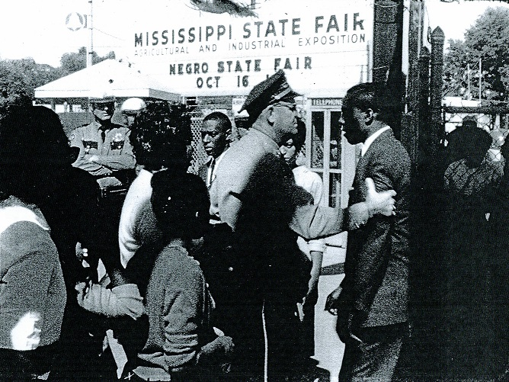

Slide 15
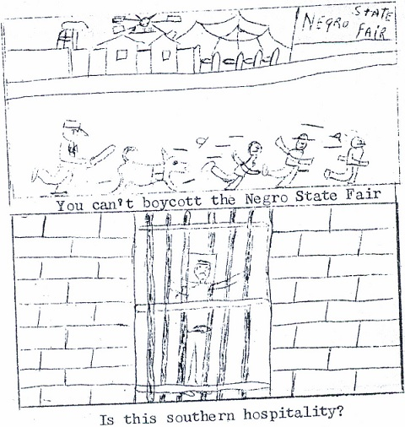
Political cartoon drawing from The Voice of the Jackson Movement (October 1962)

Slide 16
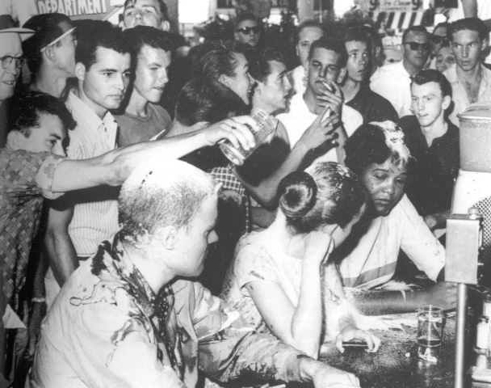

Slide 17
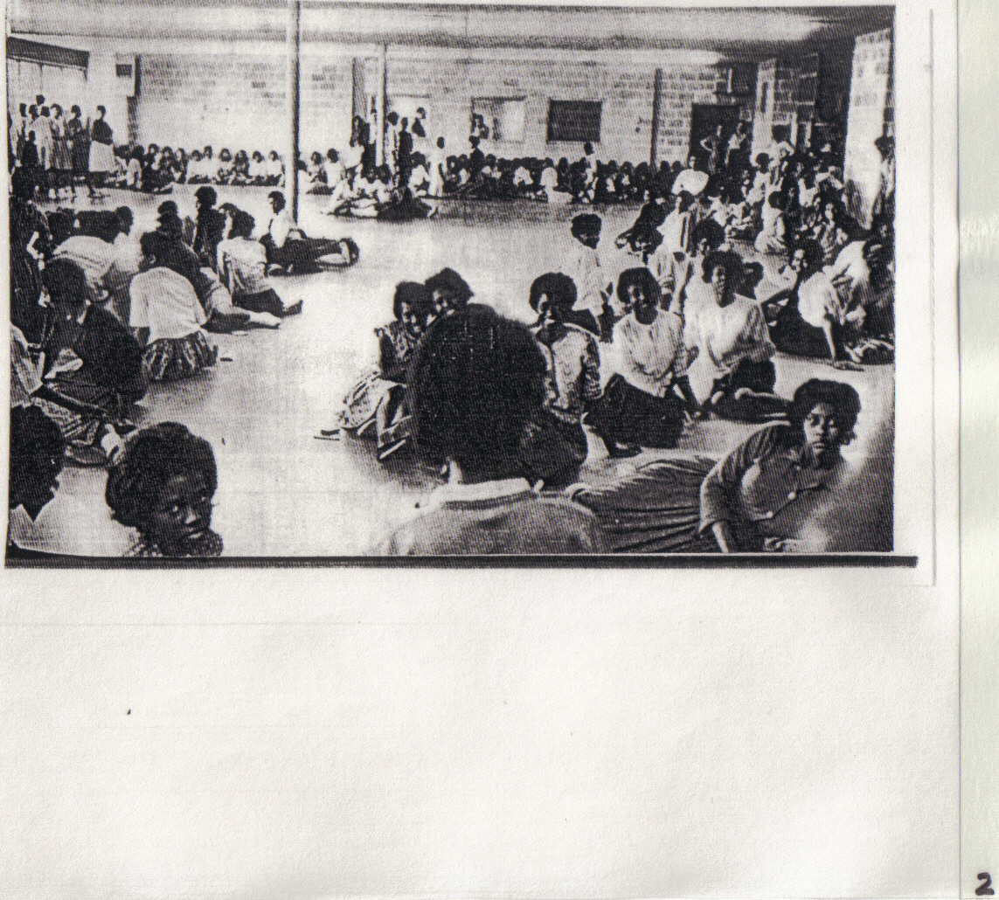

Slide 18
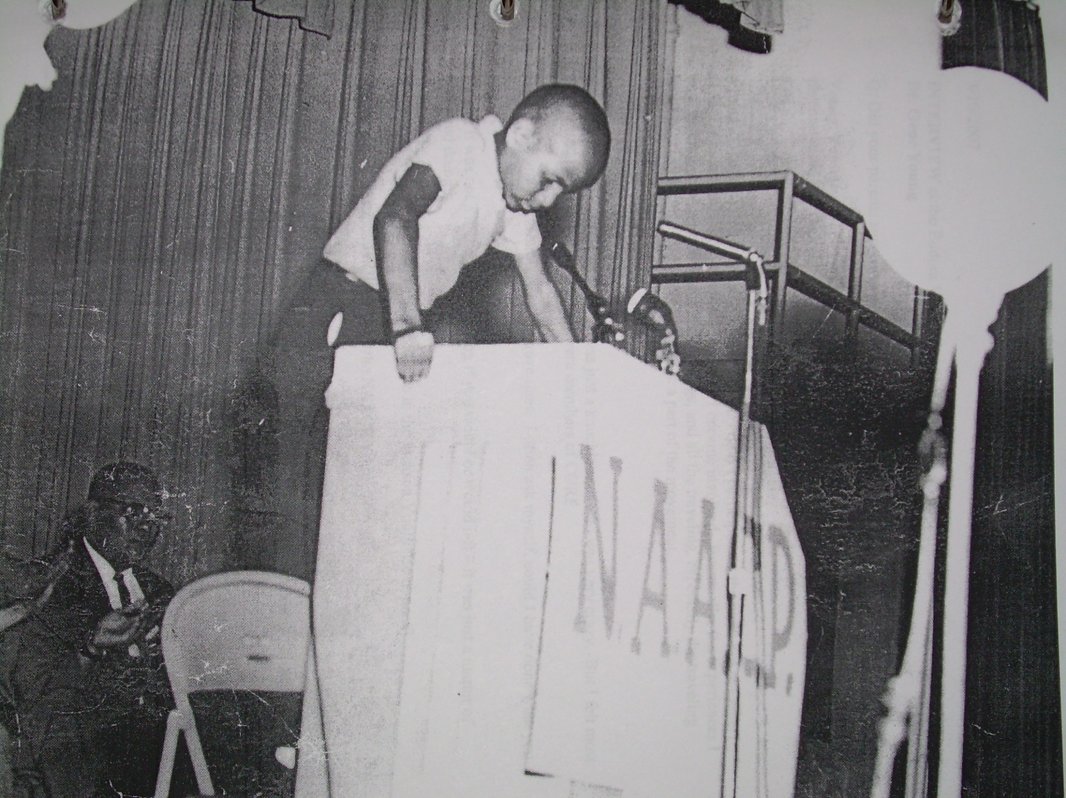
Photo Courtesy of Dr. Gene C. Young

Slide 19
I want to walk the streets of town
Turn into a restaurant and sit down
And be served the food of my choice,
And not be met by a hostile voice.
I want to live in the best hotel for a week,
Or go for a swim at a public beach.
I want to go to the best University
And not be met with violence or uncertainty.
I want the things my ancestors
Thought we’d never have.
They are mine as a Negro, an American;
I shall have them or be dead.
Alice Jackson, 17 years old
Freedom School Student
Jackson, Miss.
(1964)

Slide 20
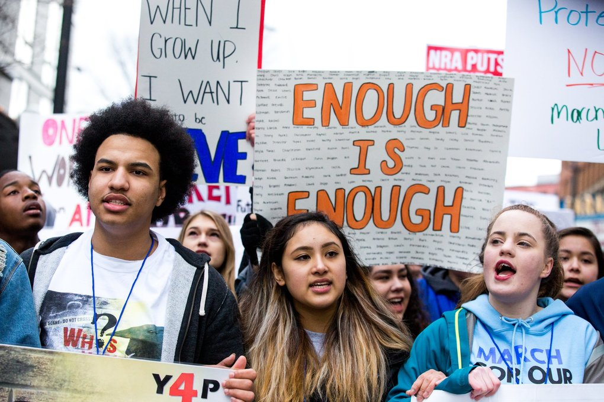

Slide 21
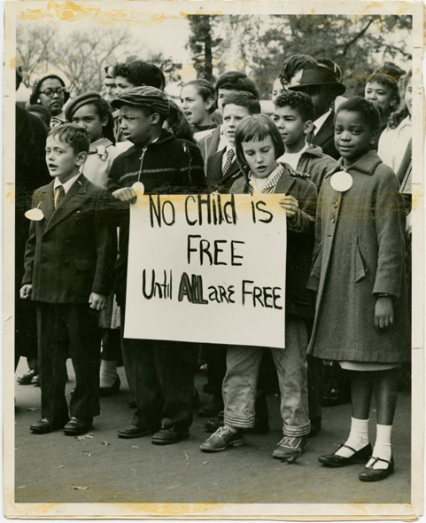
Children join a demonstration at an unidentified U.S. location for civil rights for all Americans, ca. 1960.
Photographs and Prints Division, Schomburg Center for Research in Black Culture, The New York Public Library.
http://exhibitions.nypl.org/africanaage/essay-civil-rights.html

Slide 22
TEACHING TOOLS
“Mighty Times: The Children’s March” (video)
Ellen Levine’s Freedom’s Children
Freedom School Poetry
Oral Histories and Oral History Panels

Slide 23
